Slide 1
Is religion compatible with social progress?

Slide 2
The back story
In 2015, an invitation to take part in an international project concerned with the the contributions of social science to social progress
The International Panel on Social Progress (IPSP for short)
A 3 volume report published by CUP in 2018
Think of IPSP as a ‘cousin’ to the Intergovernmental Panel on Climate Change
why do I say a cousin rather than a sibling?

Slide 3
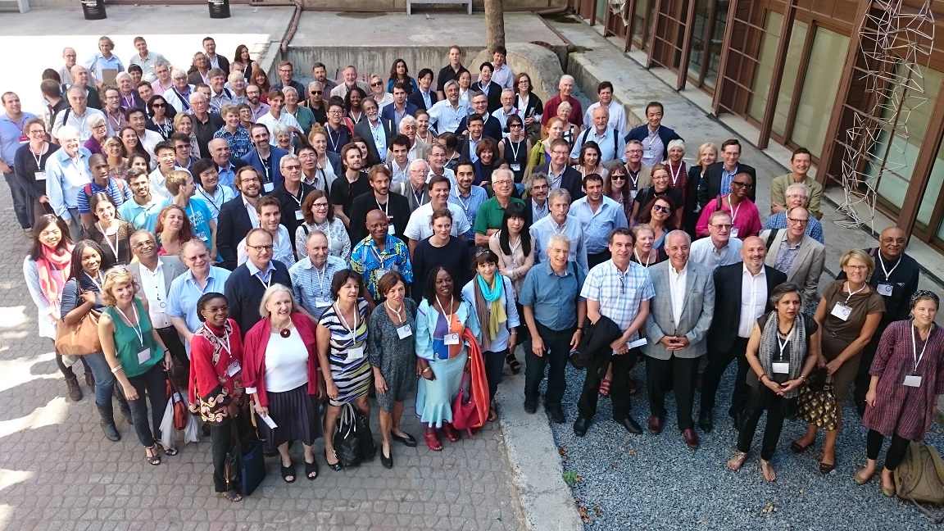
Istanbul, August 2015

Slide 4
What is social progress?
Setting aside Enlightenment assumptions that progress is somehow built into history
progress is more than GDP
associated costs (environmental)
The notion of a compass as a metaphor
setting the line of travel, but recognizing that the map in question is complex and the destination elusive
what is considered progress in one situation may be differently assessed in another (clean water as an example)

Slide 5
The chapter on religion
My task – to co-lead the team responsible for the chapter on religion within the IPSP
to address the significance of religion as a factor in social progress on a global scale
The reactions of our colleagues to this idea
why include a chapter on religion?
what is the relevance of religion to social progress – given that it is either disappearing (secularization) or, necessarily, an impediment to progress?

Slide 6
Our challenge
To find ways to counter these at best partial, and at worst inaccurate, views starting with a clear definition of religion itself
Religion is a lived, situated and constantly changing reality, and has as much to do with navigating everyday life as it does with the supernatural
Note throughout – an emphasis on lived religion, rather than belief/ practice as such

Slide 7
Some facts and figures
Crucial to our argument:
some 80 percent of the world’s population affirms some kind of religious affiliation, a proportion that is growing rather than declining
The peak of secularity/ secularism – 1970s
Significant changes in the former Soviet Union and in China
Plus differential birthrates
Thus – for good or ill – religion is central to the discussion on social progress

Slide 8
Micro to macro
Emphasizing the significance of belief and practice in everyday lives and local contexts, we analyzed the impact of religion and its relevance to social progress in a wide variety of fields:
family, gender and sexuality
diversity and democracy
conflict and peace-making
healthcare and everyday wellbeing
care for the earth

Slide 9
Further . . .
We argue that researchers and policy makers pursuing social progress will benefit from careful attention to the power of religious ideas to motivate, of religious practices to shape ways of life, of religious communities to mobilize and extend the reach of social change, and of religious leaders and symbols to legitimate calls to action
All of these, however, can be put to either good or ill, for which reason assessment of particular religions in specific contexts is essential

Slide 10
The current situation: COVID-19
Religious ideas to motivate
love your neighbour; social justice
Religious practices to shape ways of life
expressing these in new ways – on line worship
Religious communities to mobilize and extend the reach of social change - networks
practical help (foodbanks); dissemination of ideas
Religious leaders and symbols to legitimate calls to action
‘prophets’; ‘rethinking’ the future

